Slide 1

题目 Lesson-08
李老师& 开课吧人工智能学院课程组
2020.03

Slide 2
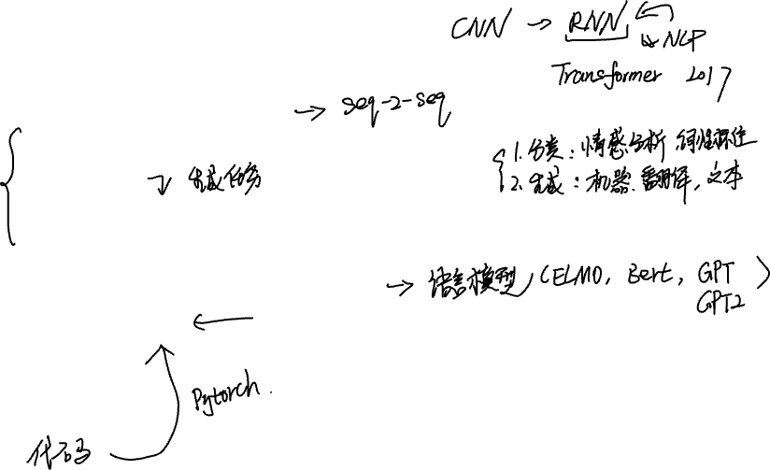
overview
Sequence to sequence
Encoder decoder architecture
Seq2Seq
Greedy search and beam search
Attention mechanism
Contextualized word representation
From word embedding to ELMo
Transformer
GPT
Bert
GPT2

Slide 3
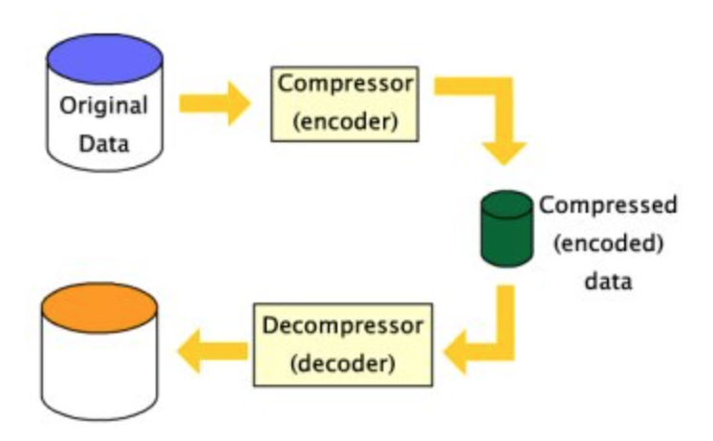
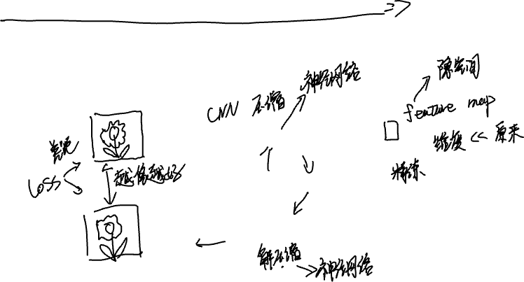
Encoder decoder architecture
The idea of encoder-decoder architecture comes from data compression.

Slide 4
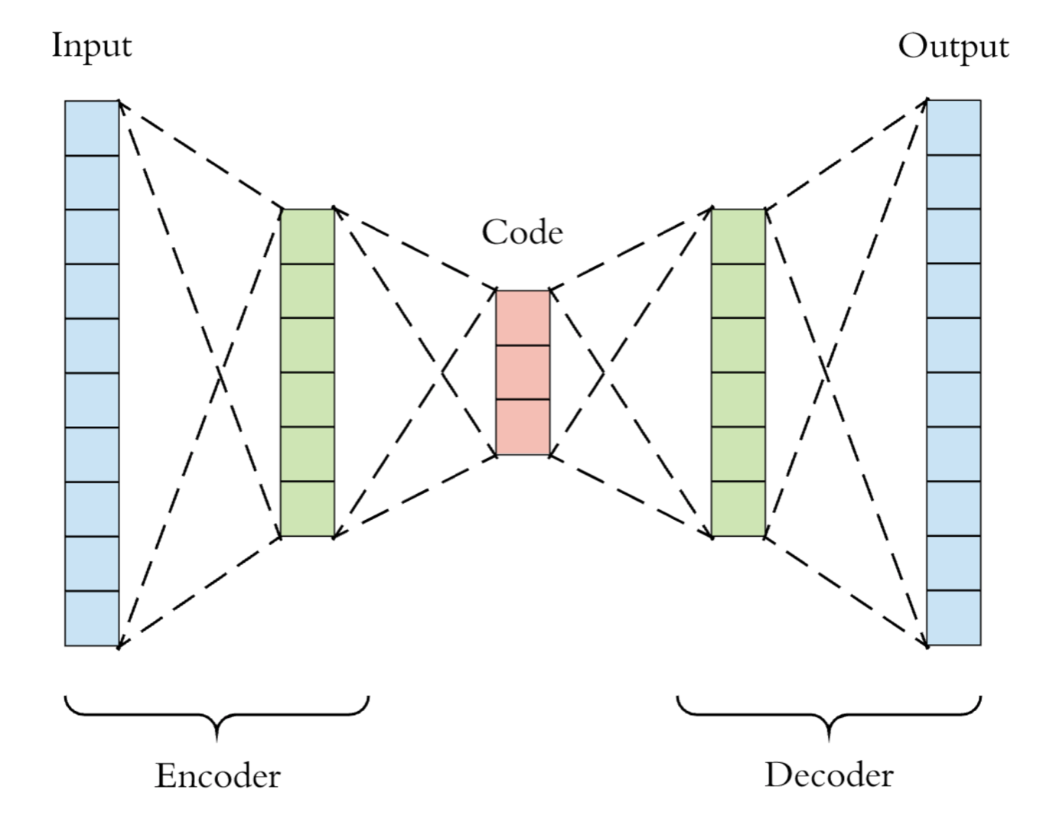
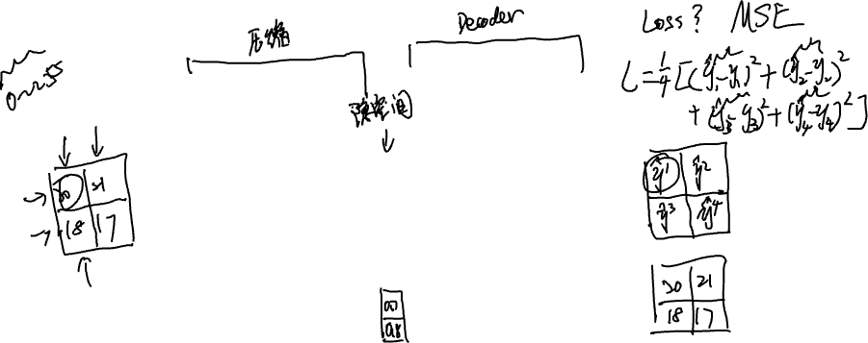
Neural encoder-decoder(autoencoder) architecture

Slide 5
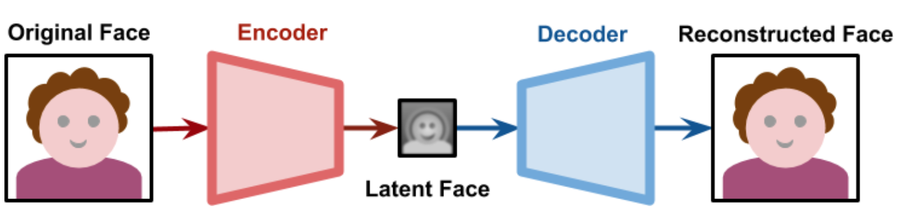
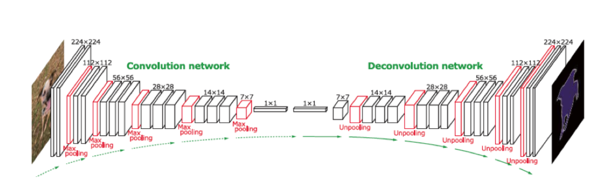
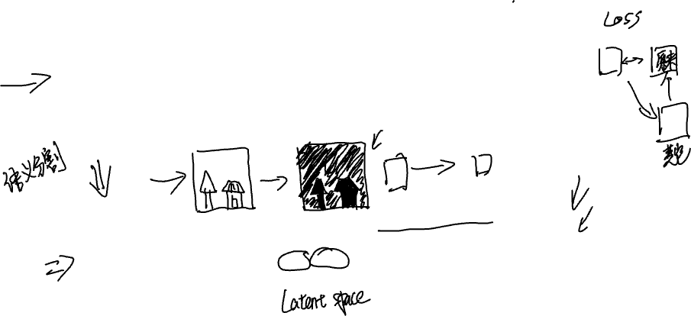
Some applications of cnn based autoencoder

Slide 6
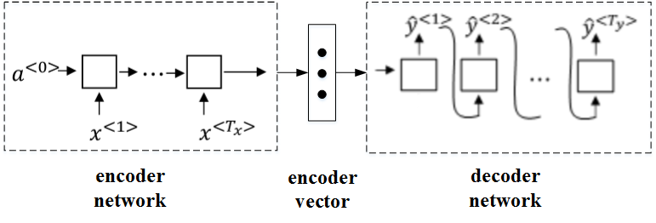
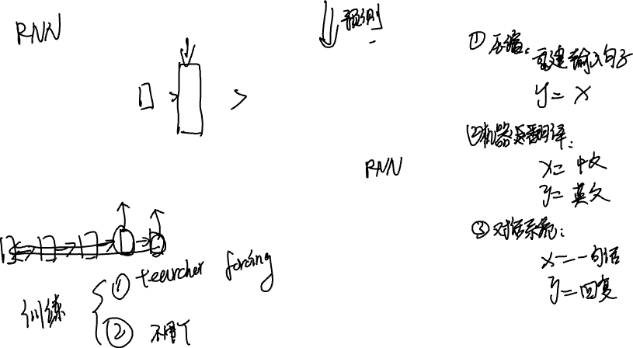
Sequence to sequence

Slide 7
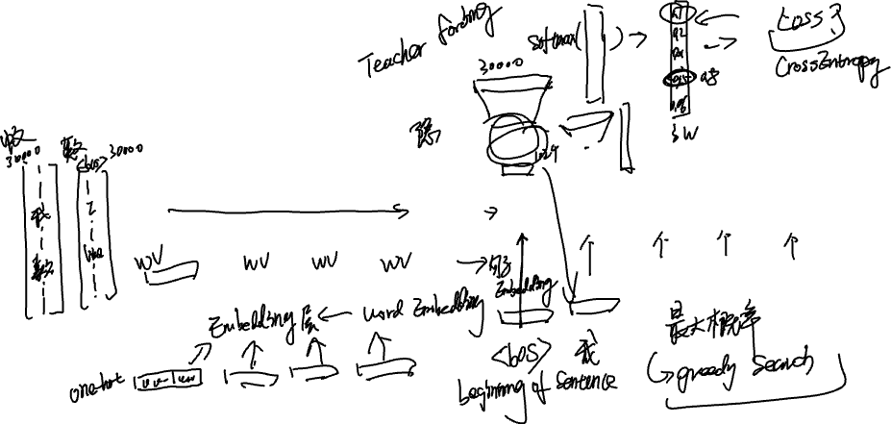
Sequence to sequence( an example of MT with greedy search)
English: I like playing basketball.
Chinese: 我喜欢打篮球
我
喜欢
打
篮球
EOS
I
like
playing
basketball

Slide 8
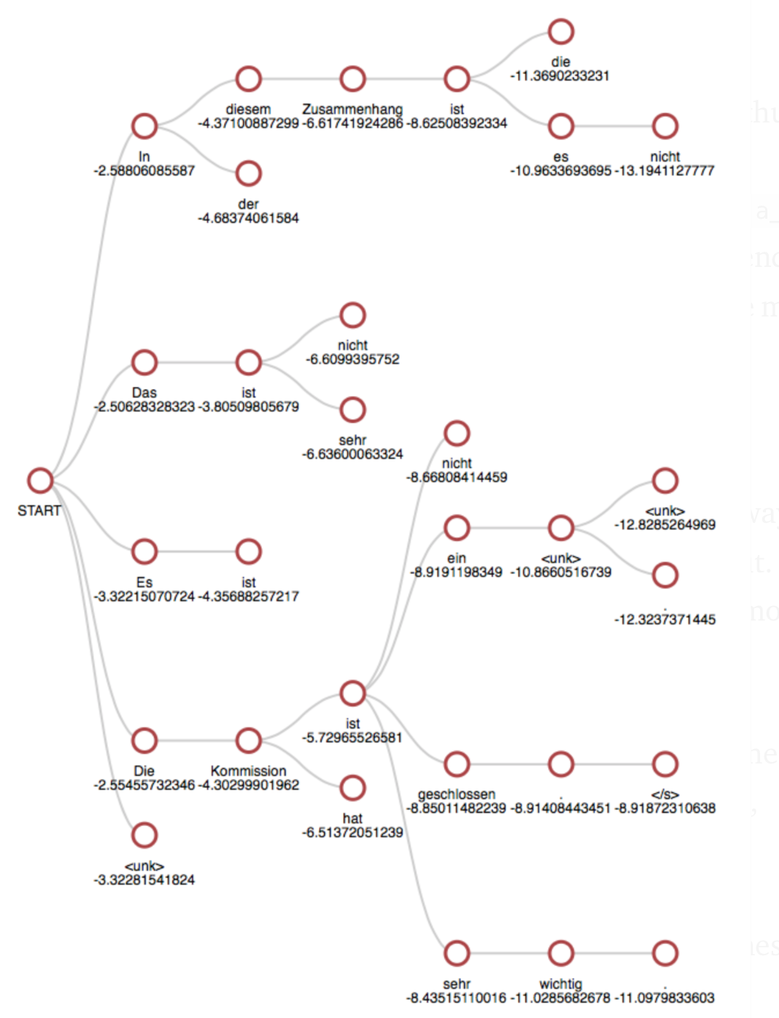
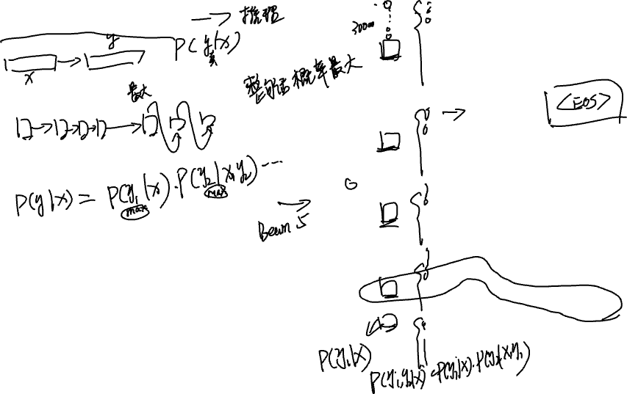
Beam search

Slide 9
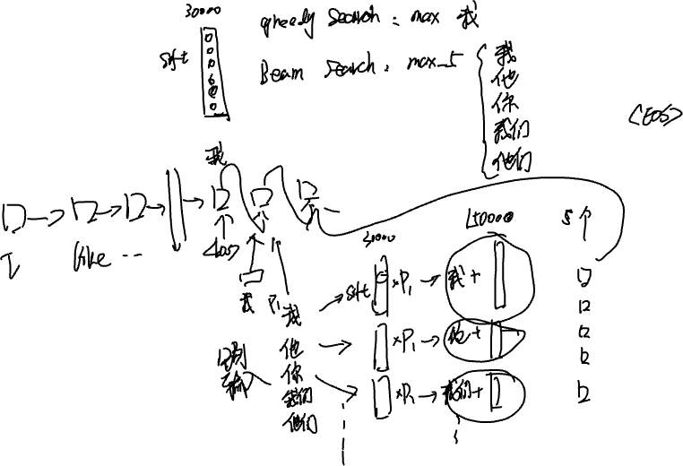


Slide 10
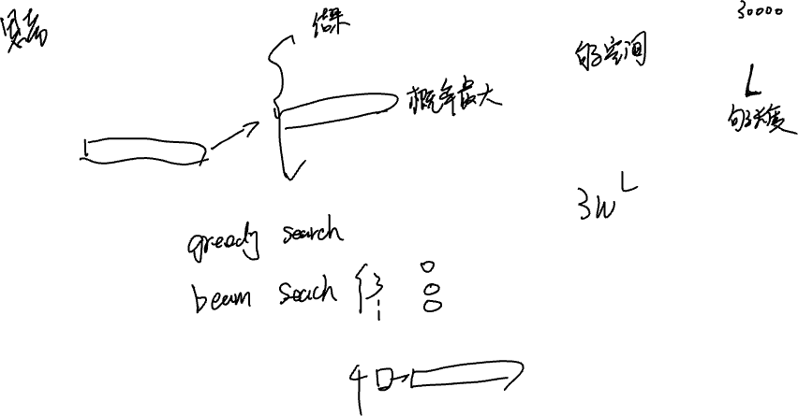

Slide 11

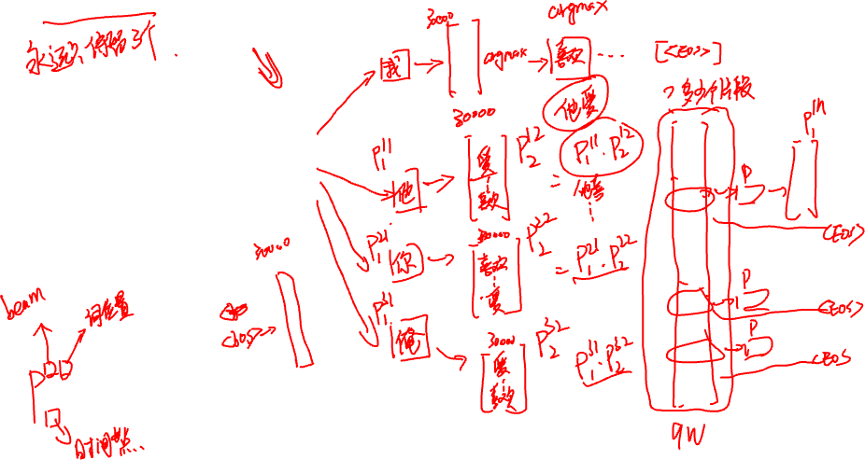
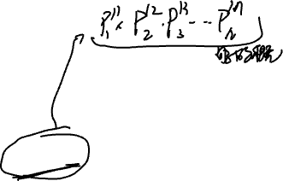
Beam search(an example)
I
like
playing
basketball

Slide 12
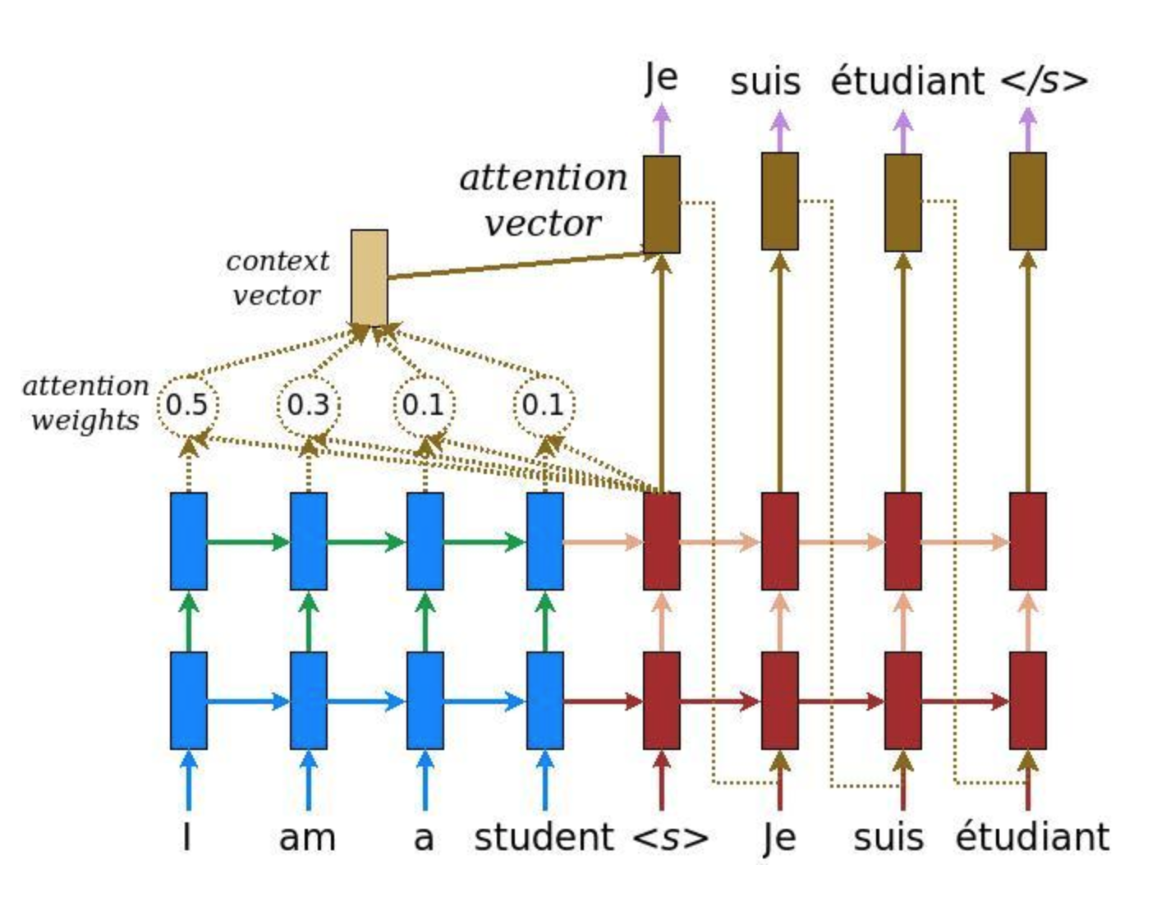
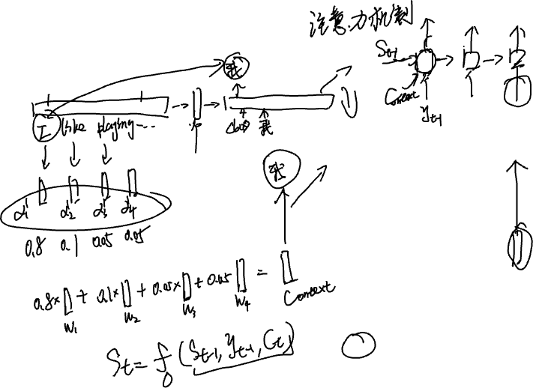
Attention mechanism

Slide 13
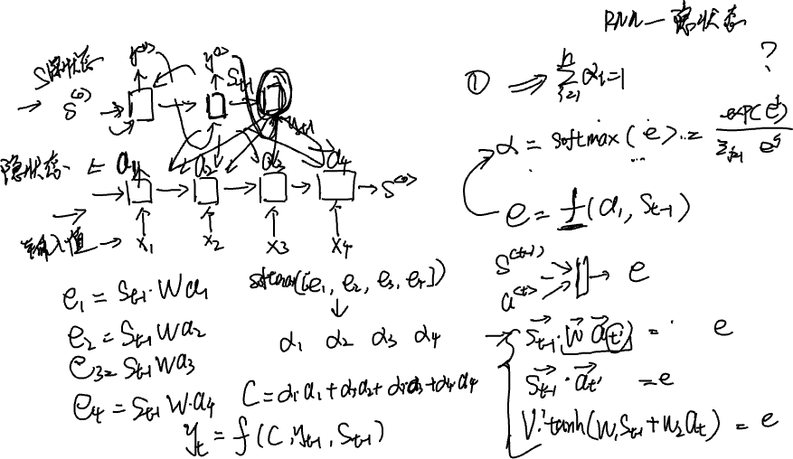

Attention mechanism(step by step)

Slide 15
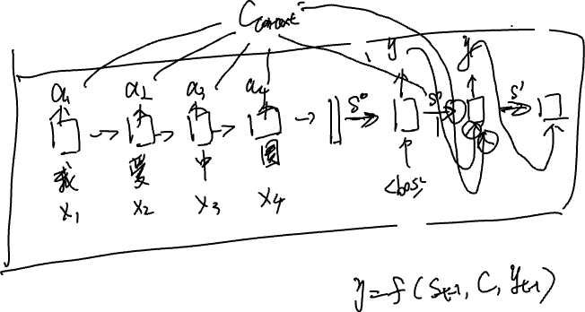

Slide 16
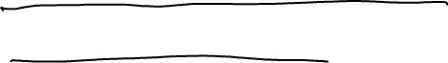
Contextualized word representation

Slide 17
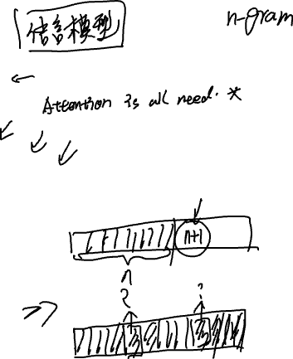

References:
ELMo paper: https://arxiv.org/pdf/1802.05365.pdf
Transformer paper: https://arxiv.org/pdf/1706.03762.pdf
Bert paper: https://arxiv.org/pdf/1810.04805.pdf
GPT paper: https://s3-us-west-2.amazonaws.com/openai-assets/research-covers/language-unsupervised/language_understanding_paper.pdf
GPT2 paper: https://d4mucfpksywv.cloudfront.net/better-language-models/language_models_are_unsupervised_multitask_learners.pdf
Blog: https://jalammar.github.io

Slide 18

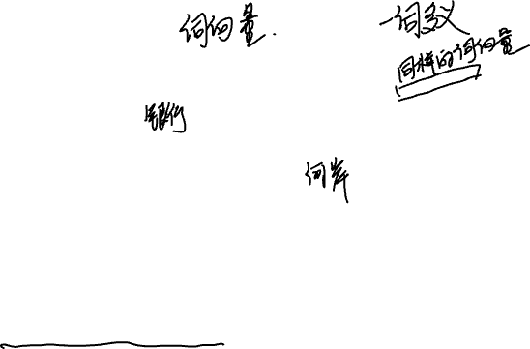
Why contextualized word representation.
Sentence 1: I must go to the bank and change some money.
Sentence 2: We pushed the boat off from the rive bank.
Two “bank” have completely different meaning.
However there is only one representation for ”bank”.
How do we solve this problem ?

Slide 19
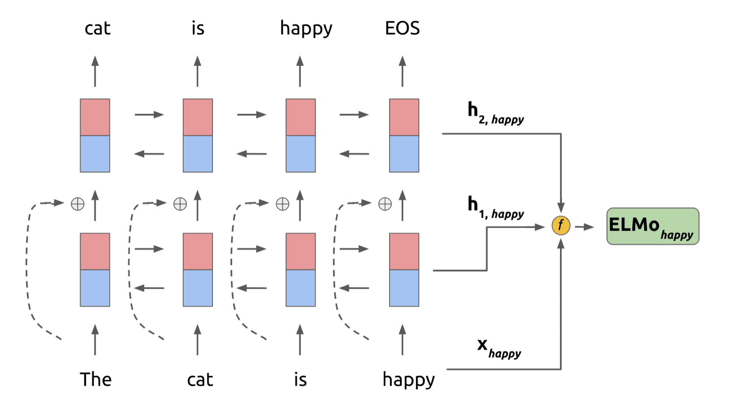
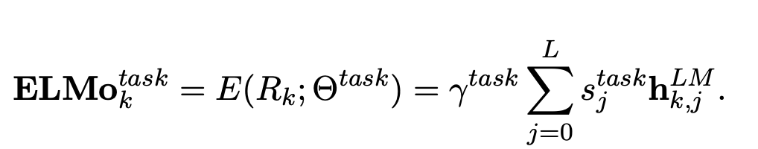
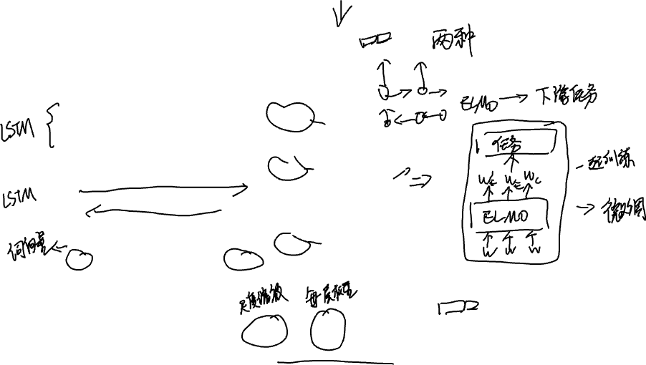
ELMo language model

Slide 20
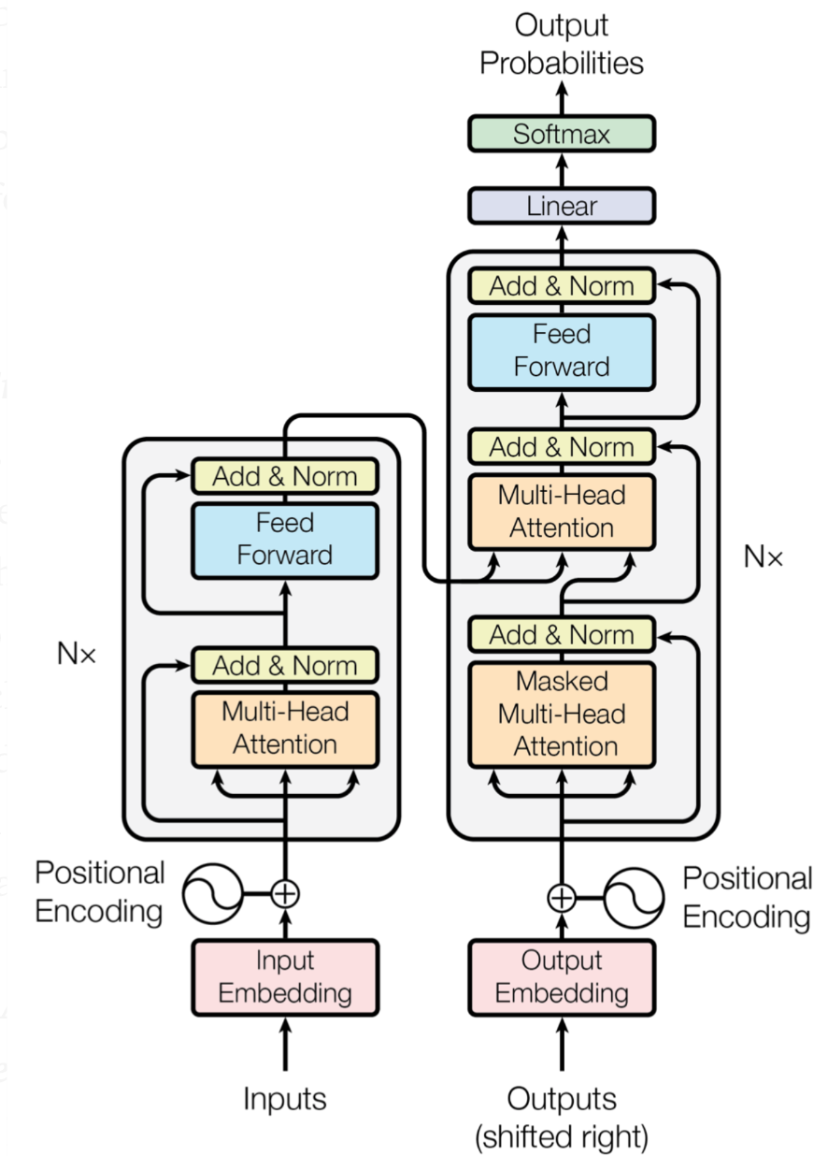

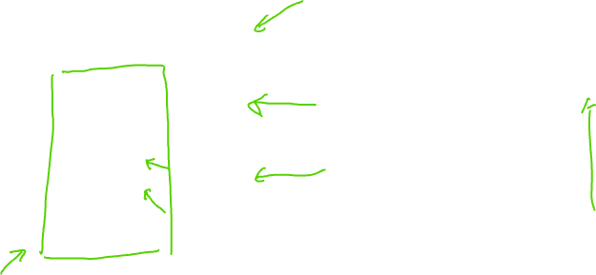

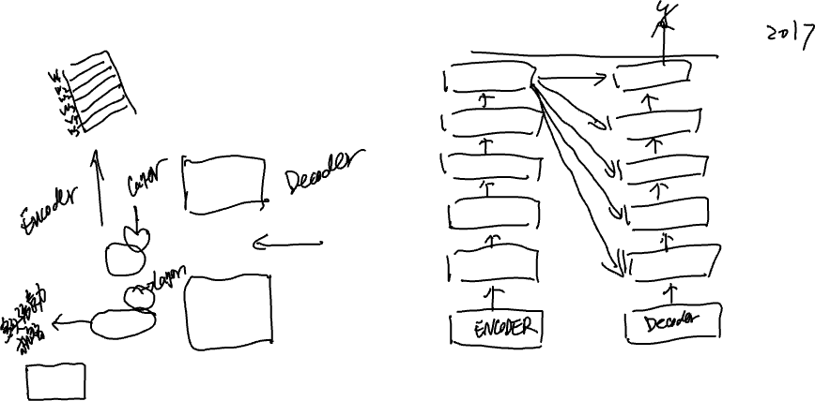

Attention is all your need. (Transformer)

Slide 21
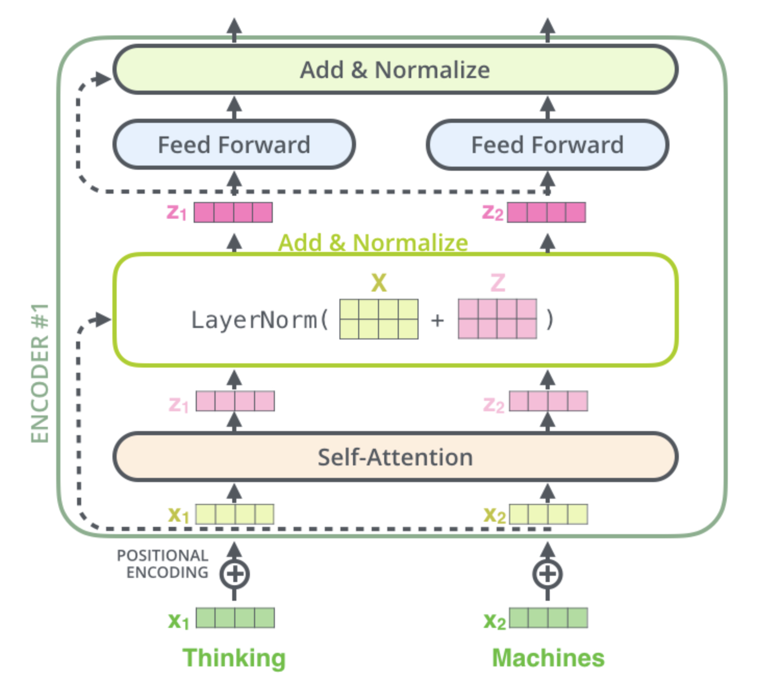
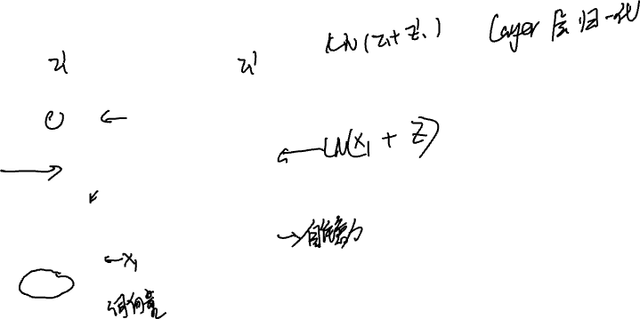

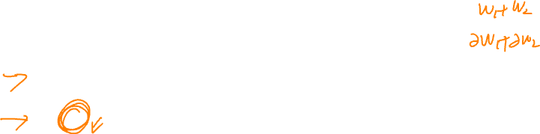
Transformer (Encoder)

Slide 22
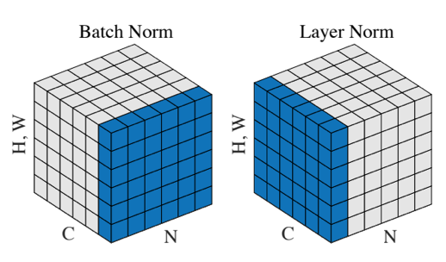


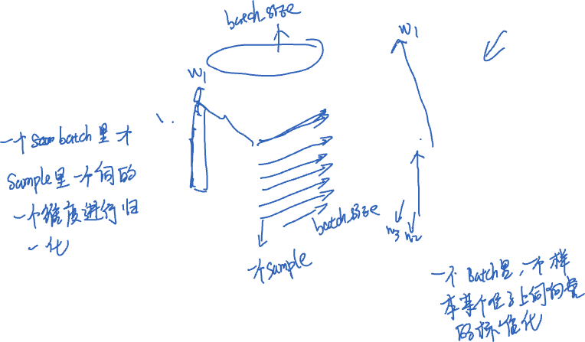

Layer normalization vs batch normalization
Batch size
Sequence length

Slide 23





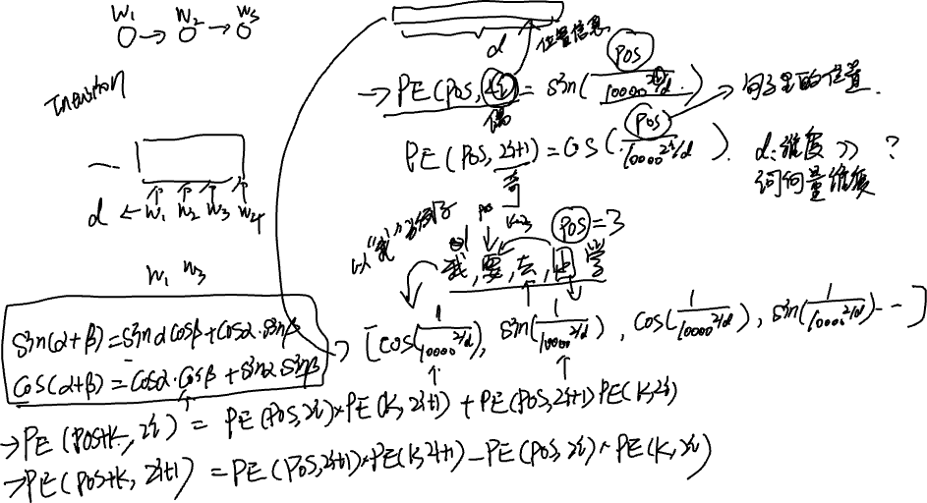

Slide 24
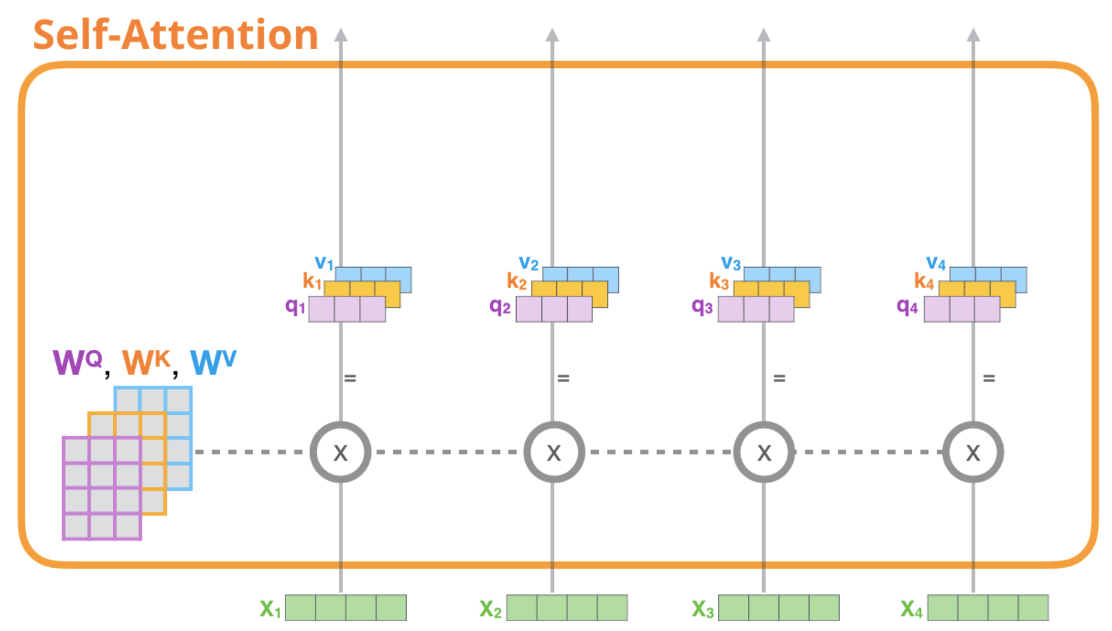
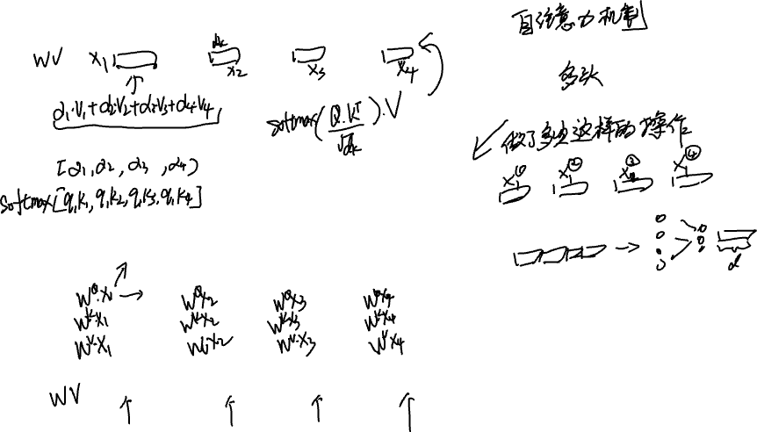
Self-Attention in detail

Slide 25
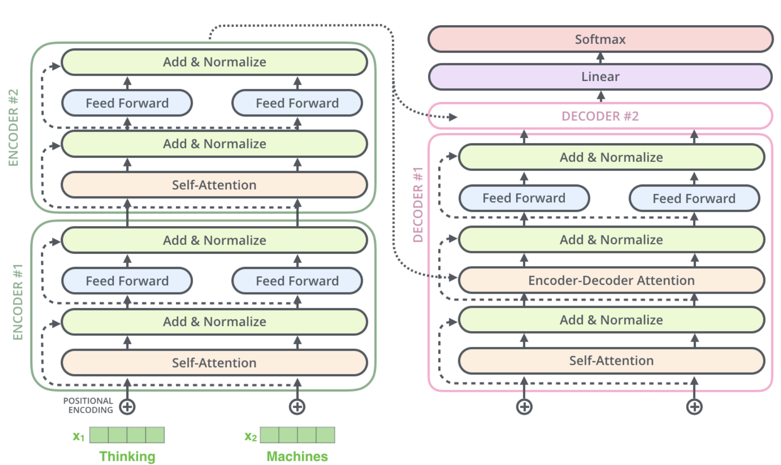
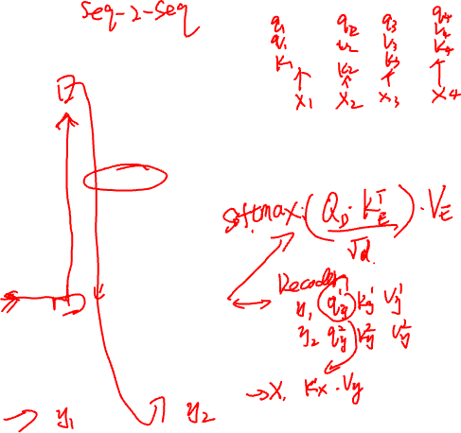
Transformer(Decoder)

Slide 26
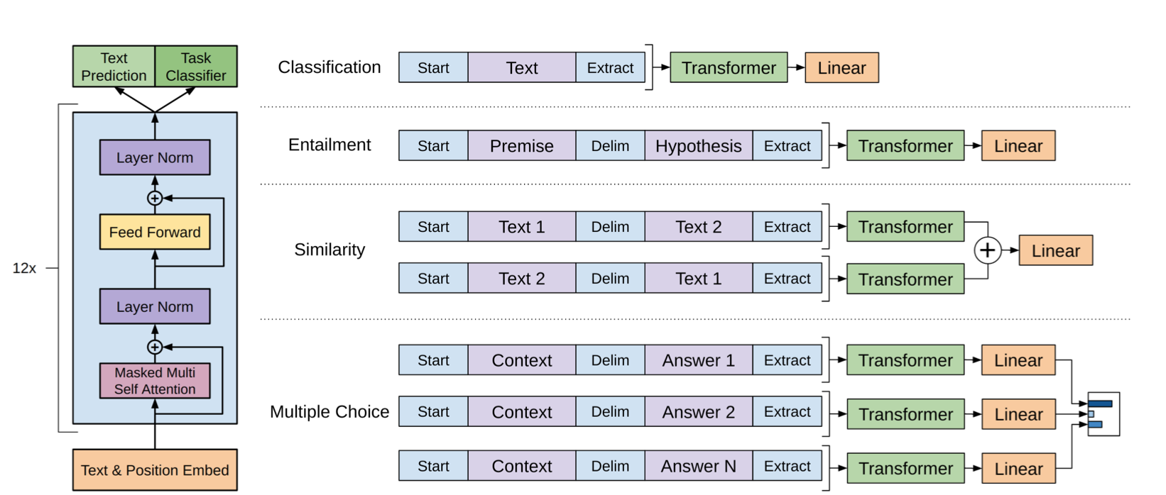
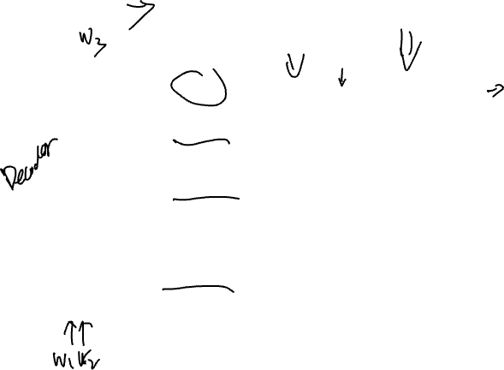
GPT

Slide 27
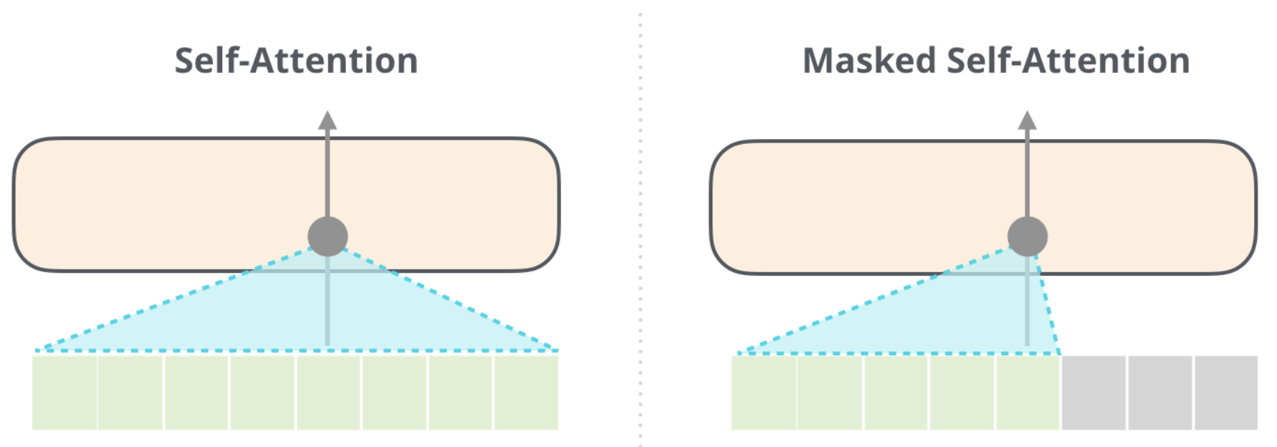
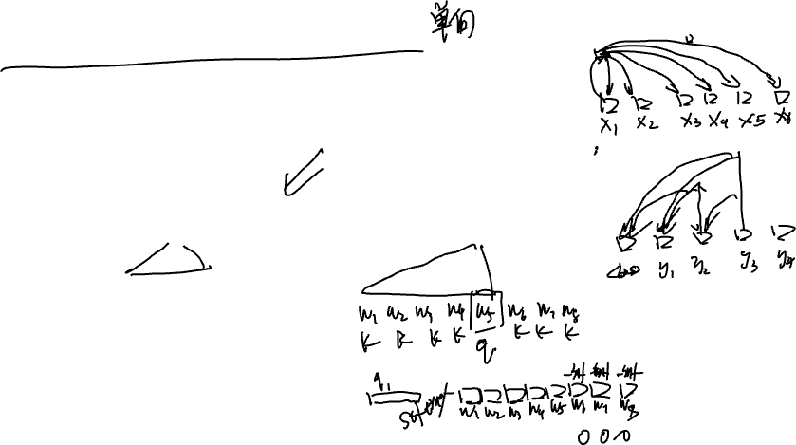
Masked self-attention

Slide 28
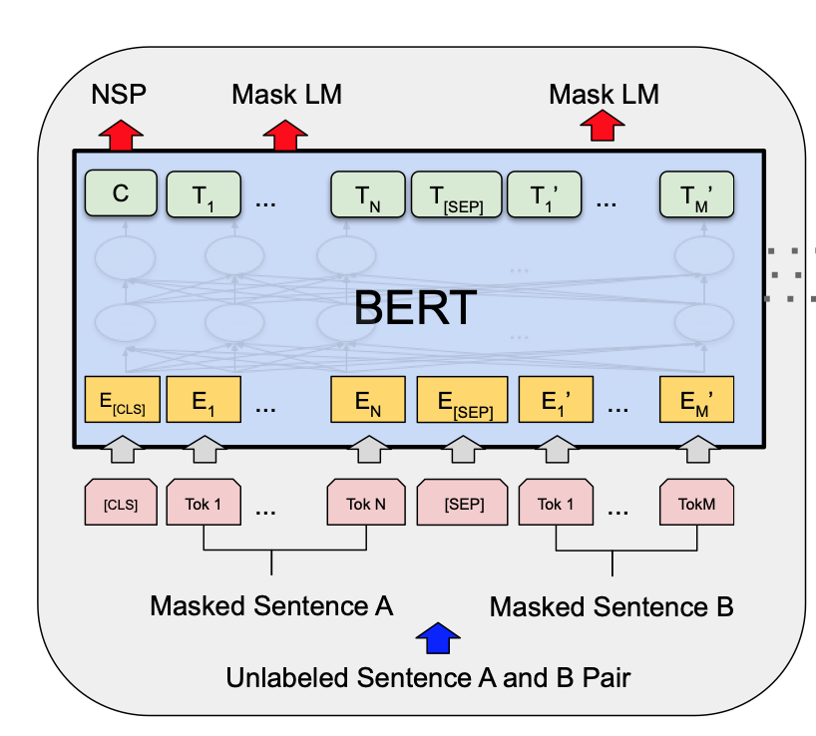
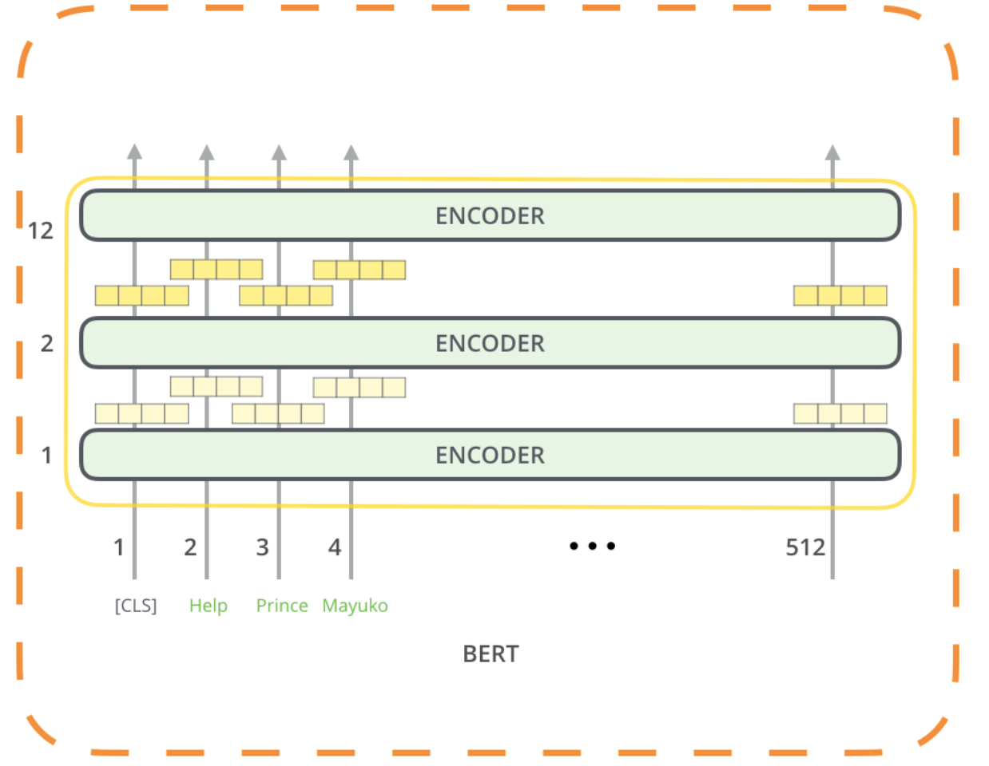
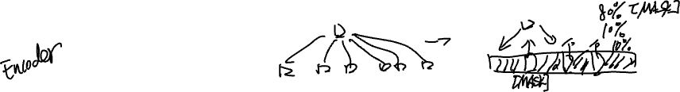
Bert

Slide 29
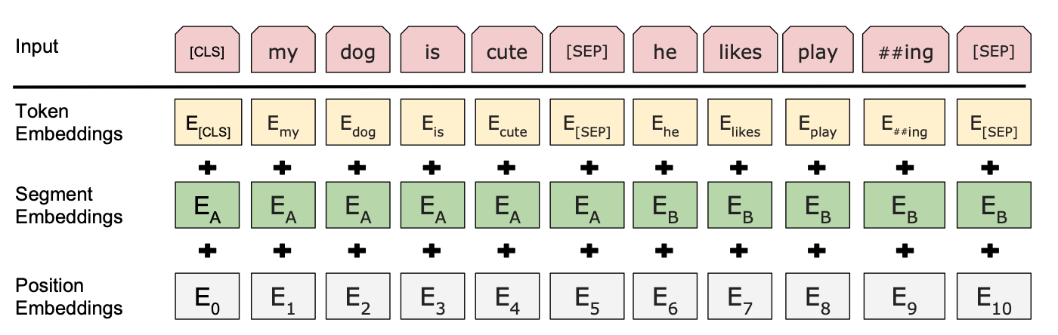
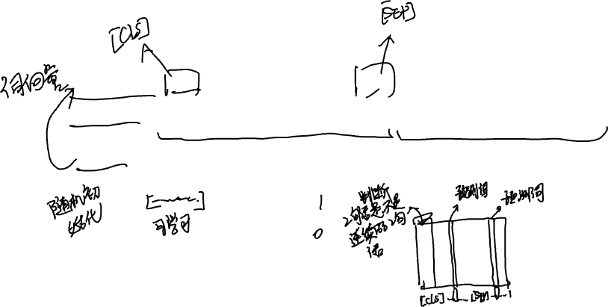
More about Bert

Slide 30
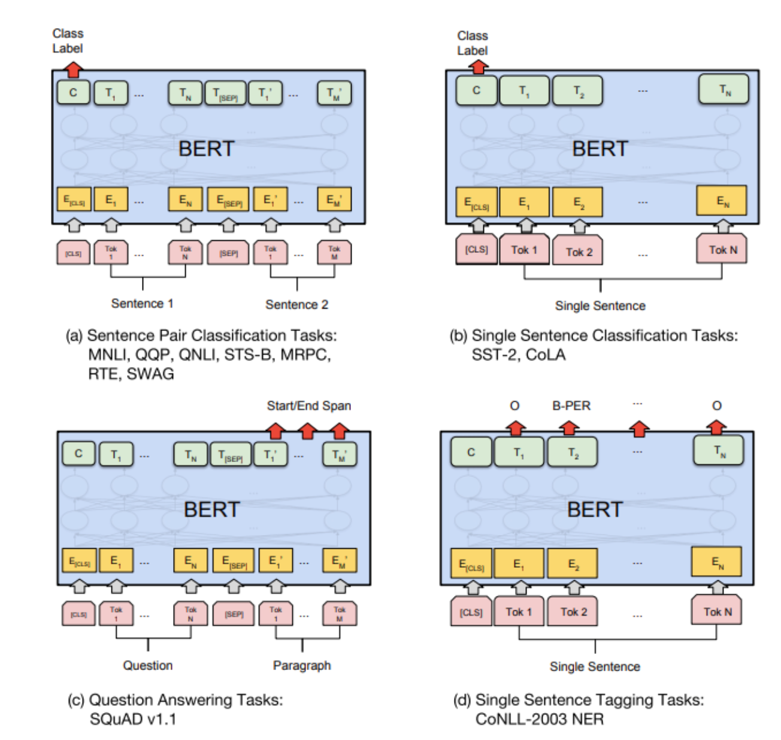

How to use Bert in other NLP tasks.

Slide 31


From GPT to GPT2 (More parameters, more data)

Slide 32



Comparisons

Slide 33

Thanks for your attending

